Slide 1

Advanced x86: BIOS and System Management Mode Internals Input/Output
Xeno Kovah && Corey Kallenberg
LegbaCore, LLC

Slide 2
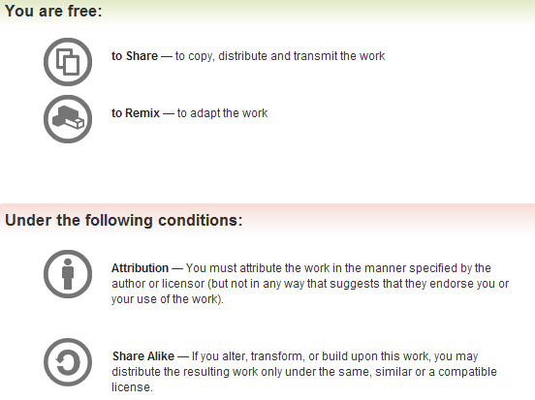
All materials are licensed under a Creative Commons “Share Alike” license.
http://creativecommons.org/licenses/by-sa/3.0/
Attribution condition: You must indicate that derivative work
"Is derived from John Butterworth & Xeno Kovah’s ’Advanced Intel x86: BIOS and SMM’ class posted at http://opensecuritytraining.info/IntroBIOS.html”
Notes:
Attribution condition: You must indicate that derivative work
"Is derived from John Butterworth & Xeno Kovah’s ’Advanced Intel x86: BIOS and SMM’ class posted at http://opensecuritytraining.info/IntroBIOS.html”

Slide 3
Input/Output (I/O)
I/O, I/O, it’s off to work we go…

Slide 4
2 Types of I/O
Memory-Mapped I/O (MMIO)
Port I/O (PIO)
Also called Isolated I/O or port-mapped IO (PMIO)
X86 systems employ both-types of I/O
Both methods map peripheral devices
Address space of each is accessed using instructions
typically requires Ring 0 privileges
Real-Addressing mode has no implementation of rings, so no privilege escalation needed
I/O ports can be mapped so that they appear in the I/O address space or the physical-memory address space (memory mapped I/O) or both
Example: PCI configuration space in a PCIe system – both memory-mapped and accessible via port I/O. We’ll learn about that in the next section
The I/O Controller Hub contains the registers that are located in both the I/O Address Space and the Memory-Mapped address space

Slide 5
Memory-Mapped I/O
Devices can also be mapped to the physical address space instead of (or in addition to) the I/O address space
Even though it is a hardware device on the other end of that access request, you can operate on it like it's memory:
Any of the processor’s instructions that reference memory can be used to access an I/O port located at a physical-memory address (MOV, for example)
Operations like AND, OR, and TEST can be used on data at a memory-mapped address
Access byte, word, dword
The MOV instruction itself requires privileges only in protected mode based on the privilege level of the descriptor describing the segment

Slide 6
Memory-Mapped I/O
For people not accustomed to working in low-level space, the term memory mapping can be a little confusing, mainly because of how the term is often used, for example:
“Device X is mapped to memory.”
People sometimes get confused by this phrasing:
Are it’s contents copied to RAM? Or are memory accesses destined for that memory range redirected (decoded) to the device?
It’s the second one. Accesses destined to that memory range are decoded to the device

Slide 7
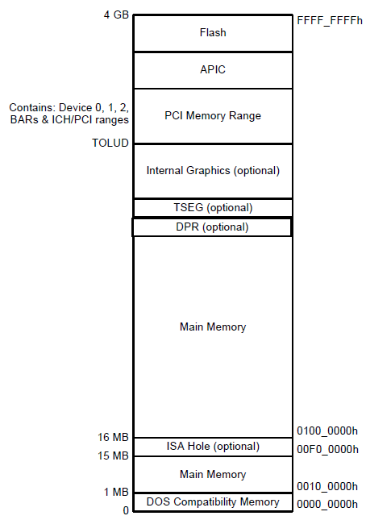
Memory Mapped IO
The colored regions are memory mapped devices
Accesses to these memory ranges are decoded to a device itself
Flash refers to the BIOS flash
APIC is the Advanced Programmable Interrupt Controller
PCI Memory range is programmed by BIOS in the PCIEXBAR

Slide 8
Peripherals that Map to Both
Devices can map to both memory and IO address space
PCI Express is a good example of devices that map to both the IO address space and the physical memory address space
Compatible PCI configuration space maps to IO Addresses CF8h and CFCh
Both Compatible PCI configuration space plus the extended header are also mapped to a memory location/size defined by the PCIEXBAR register located in the DRAM Controller
We'll get into this again once we get to PCI

Slide 9
Port I/O Address Space
Software and hardware architectures of x86 architecture support a separate address space called “I/O Address Space”
Separate from memory space
Access to this separate I/O space is handled through a set of I/O instructions
IN,OUT, INS, OUTS
Access requires Ring0 privileges
Access requirement does not apply to all operating modes (like Real-Mode)
The processor allows 64 KB+3 bytes to be addressed within the I/O space
Harkens back to a time when memory was not so plentiful
You may never see port I/O when analyzing high-level applications, but in systems programming (and especially BIOS) you will see lots of port I/O
One of the biggest impediments to understanding what's going on in a BIOS
Port 65535
0xFFFF
.
.
.
I/O Address Space
.
.
.
Port 4
0x0004
Port 3
0x0003
Port 2
0x0002
Port 1
0x0001
Port 0
0x0000
Intel Programmer’s guide, Vol 1, 16.1

Slide 10
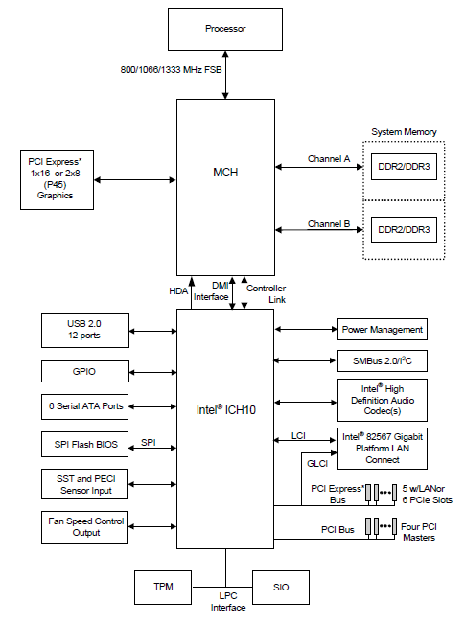
Port I/O Accesses
Port I/O access are handled by the Controller Hub (ICH/PCH)
So in a chipset that has a Memory Controller Hub (MCH), the MCH performs no translation of accesses to I/O space
The MCH just forwards them to DMI (and thus to the I/O Controller Hub)
The Controller Hub contains the registers that are located in the I/O address space
Again, separate and distinct from physical memory address space
0xFFFF
I/O
Space
0x0000
Intel Programmer’s guide, Vol 1, 16.1

Slide 11
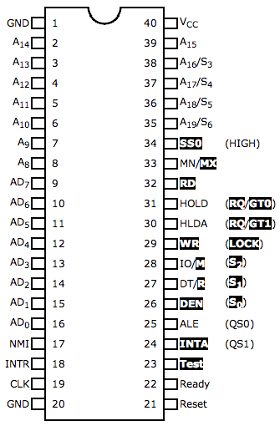

How does the hardware distinguish between port IO and memory access?
Intel 8088 chip
(from the bad old days)
There's a pin for that!
http://www.cpu-world.com/info/Pinouts/8088.html
Notes:
http://www.cpu-world.com/info/Pinouts/8088.html
http://static2.businessinsider.com/image/4ad73b48000000000004e48d/steve-jobs-pointing-apple.jpg

Slide 12
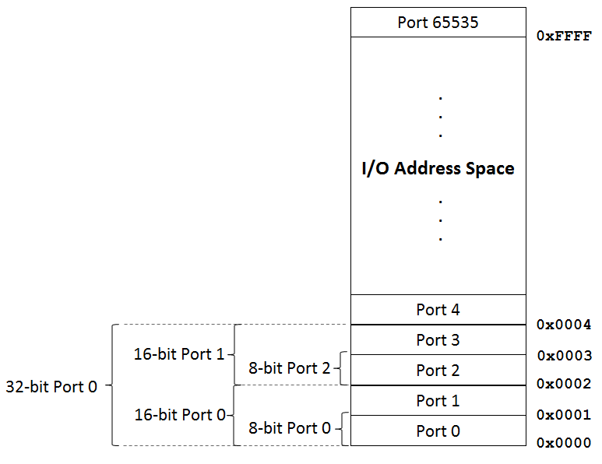
I/O Mapped Address Space
I/O Address space consists of two ranges or types of access:
Fixed
Addresses/peripherals cannot be relocated
In some instances they can be disabled, but not all
Variable
These addresses can be relocated
Can also be disabled
Addressable size can be 8 bits, 16 bits, or 32 bits

Slide 13
1. Fixed I/O Ports
The addresses depend on the implementation of the I/O Controller Hub present in your system
Check the I/O Controller Hub Datasheet to make sure you are interpreting these signals properly
Address ranges that are not listed or marked “Reserved” are not decoded by the ICH
Unless one of the variable ranges has been relocated to that address
Each fixed IO address is a 2-byte word
Remember, on the “other side” of each port address/range there is a hardware device
Device interaction and behavior will differ between devices
This is why it can be difficult to decipher when analyzing
Port I/O is a gateway to a black box
Intel, Vol 1, 16.1

Slide 14
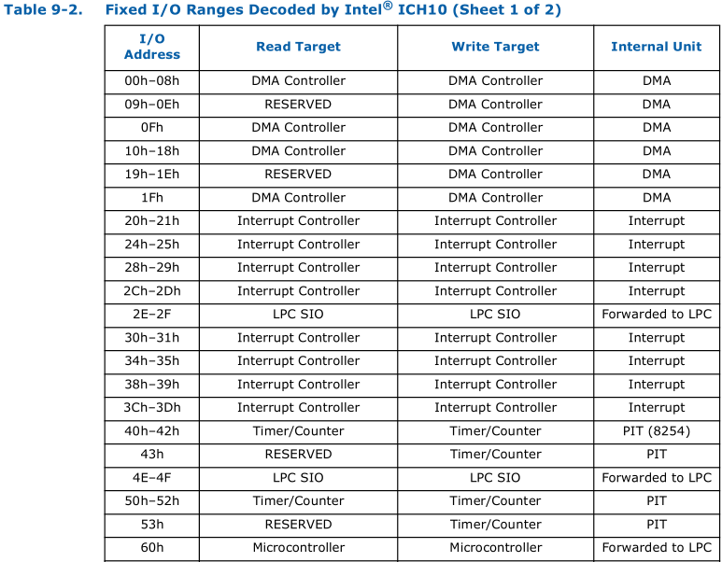
Example: ICH 9 Fixed Range

Slide 15
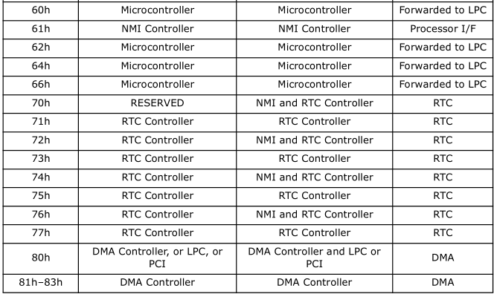
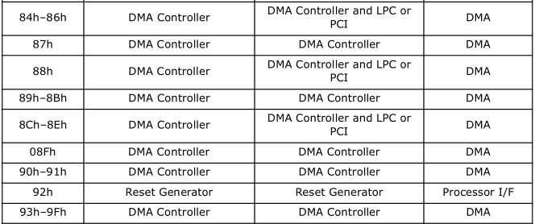
Port 60 is the historic location of the 8042 keyboard controller status/command port. And port 64 is the data port. Notice how it doesn't tell you that, it just says they're being forwarded on to LCP. Annoying for trying to figure out what's being talked to

Slide 16
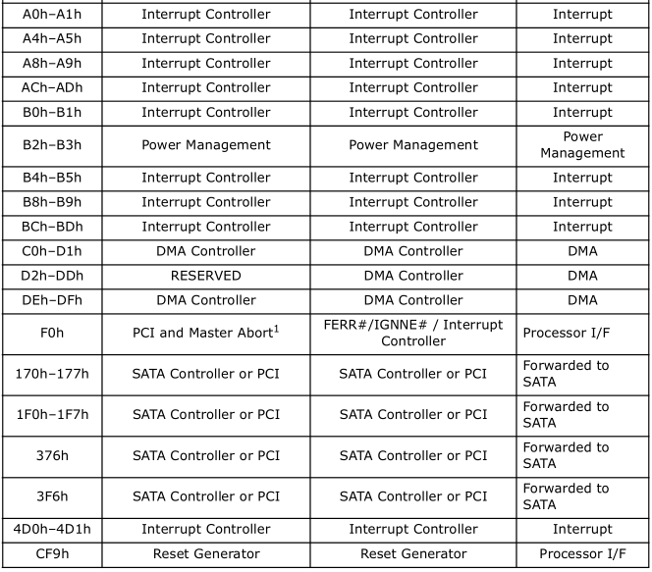
This one we’ll
talk about
explicitly later in the
context of SMM
Takeaway: there’s a lot of fixed IO address space, and it’s fragmented too. This is why it’s recommended that devices map their interfaces to memory rather than IO address space

Slide 17
2. Variable I/O Ports
Can be relocated to another address
Can be set/disabled using Base Address Registers (BARs) or configuration bits in the various PCI configuration spaces
Which we shall discuss very soon!
The BIOS (and/or other PCI devices or ACPI) can adjust these values
Actually pretty much any privileged app can…
The same as the fixed range, on the “other side” of each port address/range there is a peripheral device
Device interaction and behavior will differ between devices
ICH does not check for overlap
Results “unpredictable” if overlapping
Has been used for virtualization attacks
Intel, Vol 1, 16.1

Slide 18
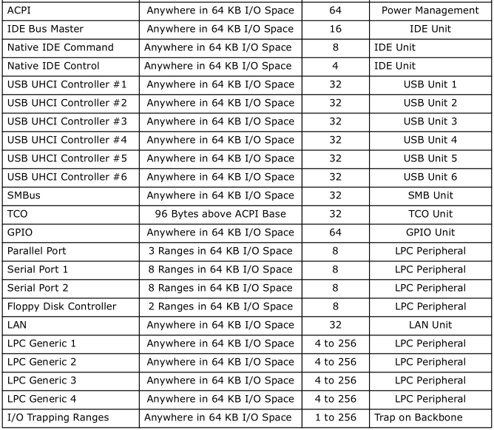
Example: ICH 9 Variable IO Range

Slide 19
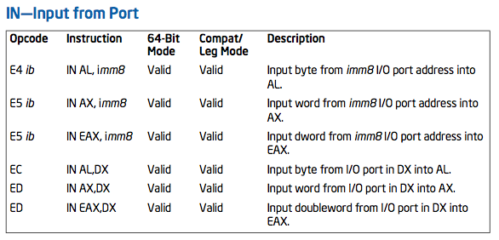
IN - Input from Port
Note it's DX, not DL. That means the DX form can specify all 2^16 ports, but the IMM8 form can only specify 2^8 ports.
“When accessing a 16- and 32-bit I/O port, the operand-size attribute determines the port size.” (Because as usual there's an overloaded opcode for 16/32 bit form)
Remember if you're in a 16 bit segment it's 16 bit, if you're in a 32 bit segment it's 32 bit. But you can override it with an operand size instruction prefix which is talked about later.
From Xeno Kovah’s Intermediate X86 class: http://OpenSecurityTraining.info/IntermediateX86.html

Slide 20
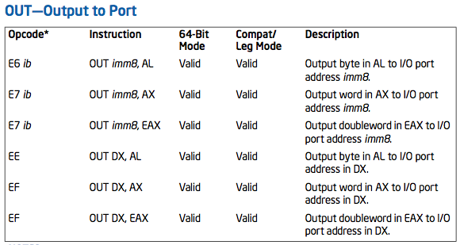
OUT - Output to Port
Basically the same caveat as IN
From Xeno Kovah’s Intermediate X86 class: http://OpenSecurityTraining.info/IntermediateX86.html

Slide 21
IO Privilege Level
There are two bits in the *FLAGS register which the OS will typically set to 0, which indicate that only ring 0 is allowed to issue the IN/OUT instructions

Slide 22
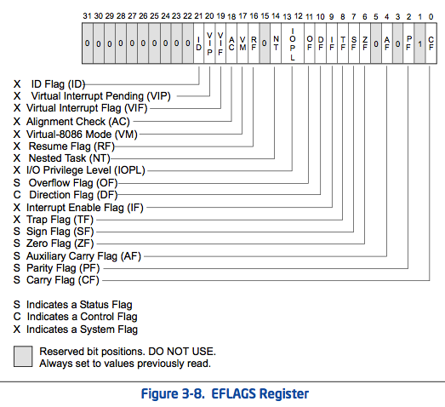
= Intro x86-64
= Intermediate x86-64
I
O
P
L
I
D
R
F
O
F
D
F
I
F
T
F
S
F
Z
F
A
F
P
F
C
F
Intel Vol 1 Sec 3.4.3.1 - page 3-21 - May 2012 manuals

Slide 23
Port IO Assembly Examples (showing that you can either use an 8 bit immediate or a 16 bit register (dx) to specify port and 8 bit immediate or 8/16/32 bit registers (but only AL/AX/EAX) to specify the data being read/written)
Read from port 0xB3:
IN AL, 0xB3
MOV AX, 0x1234
MOV DX, 0xB2
OUT DX, AX
Write 0x1234 to port 0xB2:
MOV AX, 0x1234
OUT 0xB2, AX
Index/Data pair read offset 0x05:
MOV DX, 0x70
OUT DX, 0x05
MOV DX, 0x71
IN EAX, DX
MOV AL, 0x05
MOV DX, 0x70
OUT DX, AL
MOV DX, 0x71
IN EAX, DX
Index/Data pair write to offset 0x05:
MOV AL, 0x05
MOV DX, 0x70
OUT DX, AL
MOV DX, 0x71
MOV EAX, 0x10
OUT DX, EAX
Notes:
You should use cli, sti to clear/set interrupts prior to doing these reads/writes
Also technically you should go through the controller to avoid race conditions

Slide 24
Port IO
MOV DX, PORT
OUT DX, IMM8
CPU
Black Box
MOV DX, PORT
IN AX, DX
CPU
Black Box
IMM8 (one byte constant) could be a command or data – that’s up to the interpretation by the device
It is not necessarily known what the black box on the end of a port does
Check your Controller Hub datasheet and/or the LPC decode registers (might offer clues)

Slide 25
Port IO Index/Data Pair
MOV DX, 0x70
OUT DX, IMM8
MOV DX, 0x71
OUT DX, IMM8
CPU
Black Box
Some devices use an index/data pair for IO
An offset is written to the index port
Next a value is read from or written to that offset from the Data port
Devices such as this are CMOS, PCI, and the Keyboard Embedded Controller on the E6400 (per the below research)
http://esec-lab.sogeti.com/dotclear/public/publications/11-recon-stickyfingers_slides.pdf

Slide 26

Identifying Port I/O
First try deciphering port IO devices by using the datasheets (Controller Hub either ICH or PCH)
OS Dev
http://wiki.osdev.org/I/O_Ports (which links you to...)
Boch’s or Ralf’s
http://bochs.sourceforge.net/techspec/PORTS.LST
Last change was in 11/6/94 and that’s just how it is with most BIOS information
Vendors can extend a device interface to any unoccupied IO address

Slide 27
UEFI indirection
When we eventually get to UEFI you will see that there’s a lot of indirection.
So this is just to say that if you were REing some code, while you might eventually find the actual IN/OUT instructions, it would suffice to find “EFI_CPU_IO2_PROTOCOL.Io.Read() and Io.Write()” which are functionally equivalent
You can read more about them in the UEFI specs’ Volume 5

Slide 28
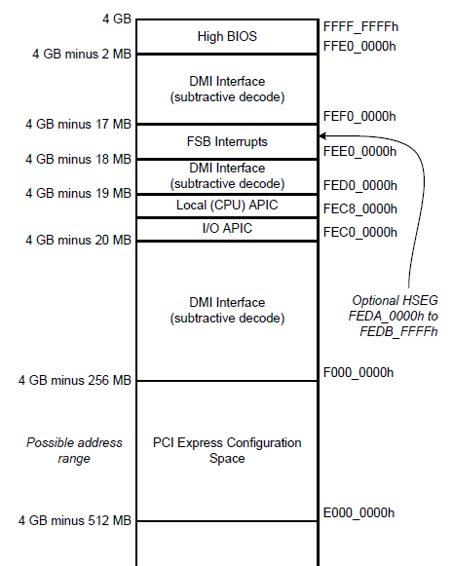
Example: Port IO Configuring PCIEXBAR
Chipset
DRAM Controller | B0:D0:F0
Offset | Name | Value
60h | PCIEXBAR | F8000001h
F800_0000h
On the Mobile 4-Series Chipset, the BIOS (executed by the CPU), configures the PCIEXBAR in the DRAM Controller
F800_0000h (on an E6400 with 4GB RAM for example)
PCI Memory range is now mapped
So how does this configuration actually occur? PCI…
Notes:
As previous, this logical diagram shows the connection between the CPU and the rest of the system. The CPU is connected directly to the Chipset northbridge.

